Slide 1
Data Analyst Project
EduBridge India's
On
data analysis with machine learning (python)

Slide 2

Dataset =
The problem involves a given dataset that we visualise, sort using the EDA method, and find the most relevant value using machine learning algorithms.
Extracted from kaggle

Slide 3
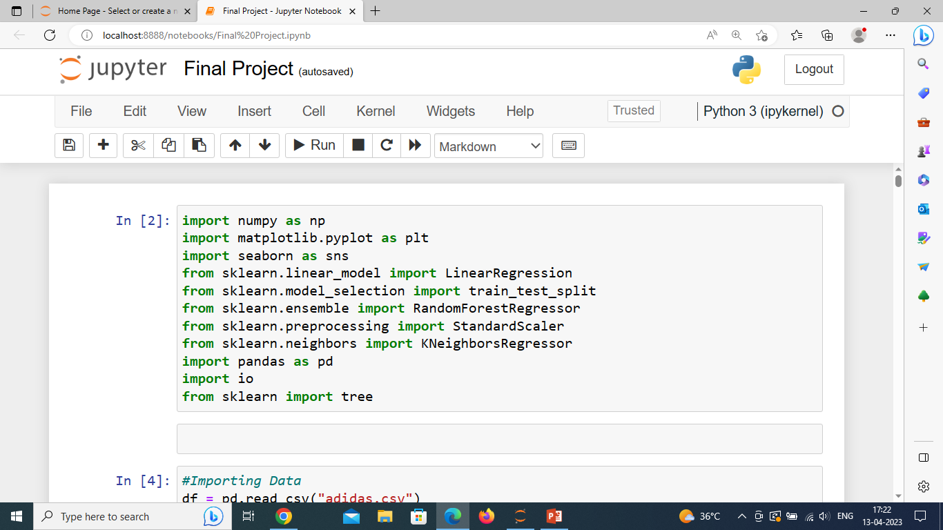
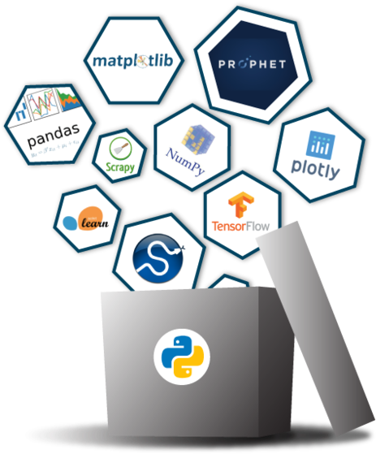
Importing Libraries
NumPy is a Python library used for working with arrays.
Matplotlib is a comprehensive library for creating static, animated, and interactive visualization.
Seaborn is a Python data visualization library based on matplotlib.
Sklearn package provides the functions for data mining and machine learning algorithms for data analysis.
Pandas is defined as an open-source library that provides high-performance data manipulation in Python.

Slide 4

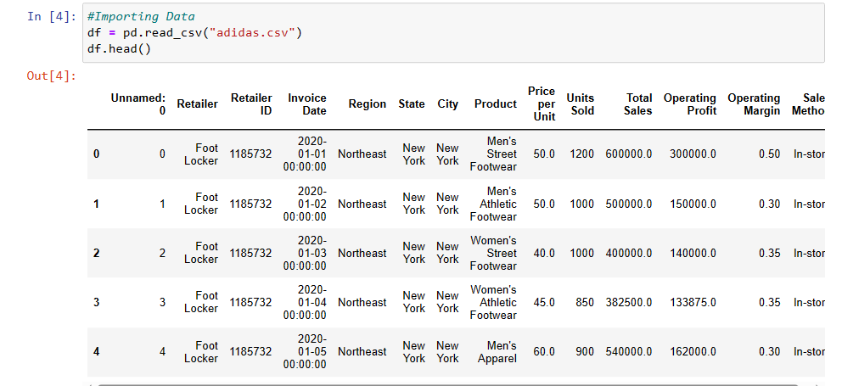
Using the read_csv() function from the pandas package, you can import tabular data from CSV files into pandas dataframe
(Comma Separated Values)

Slide 5
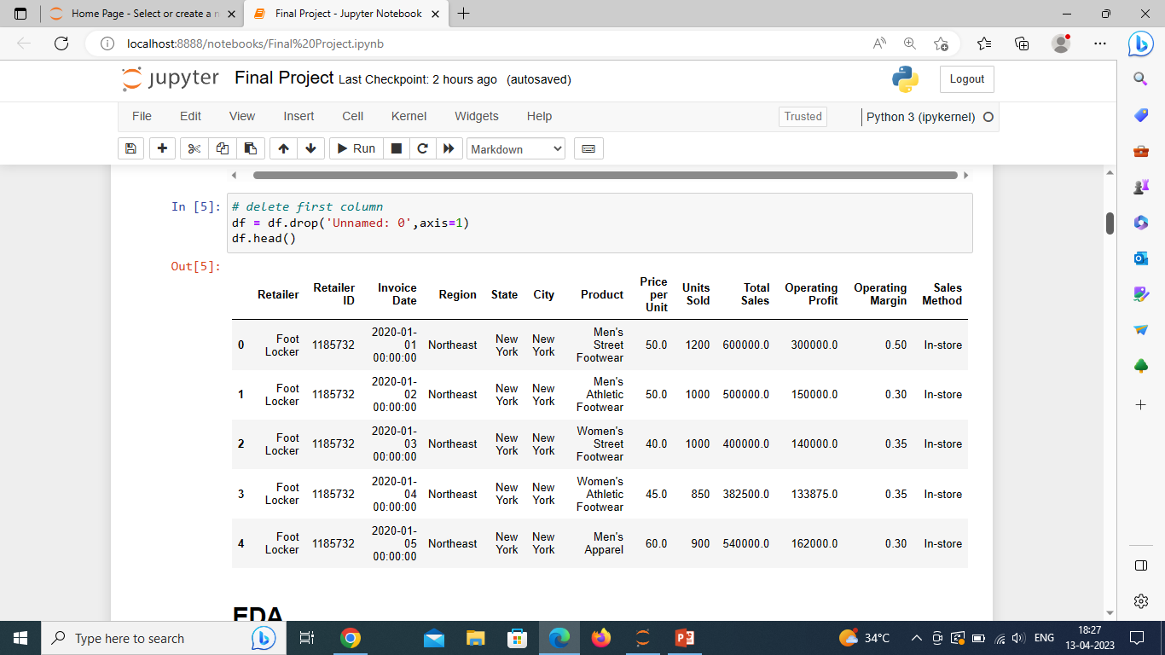
Remove rows or columns by specifying label names and corresponding axis Return the first n rows

Slide 6
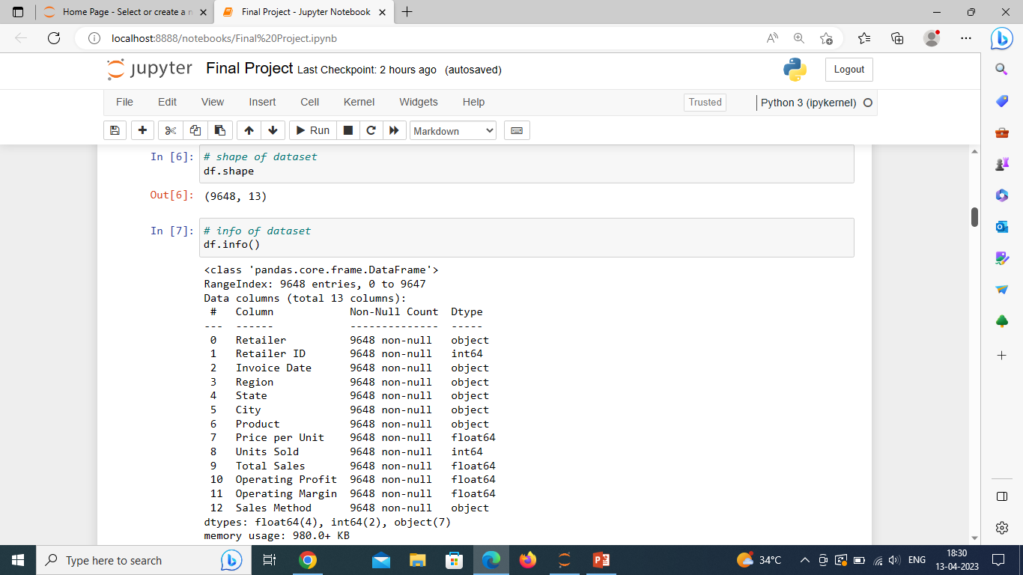
DataFrame is made up of 9648 rows and 13 columns of data. The info() method prints information about the DataFrame
Exploratory Data Analysis (EDA)
is an approach to analyze the data using visual techniques.

Slide 7
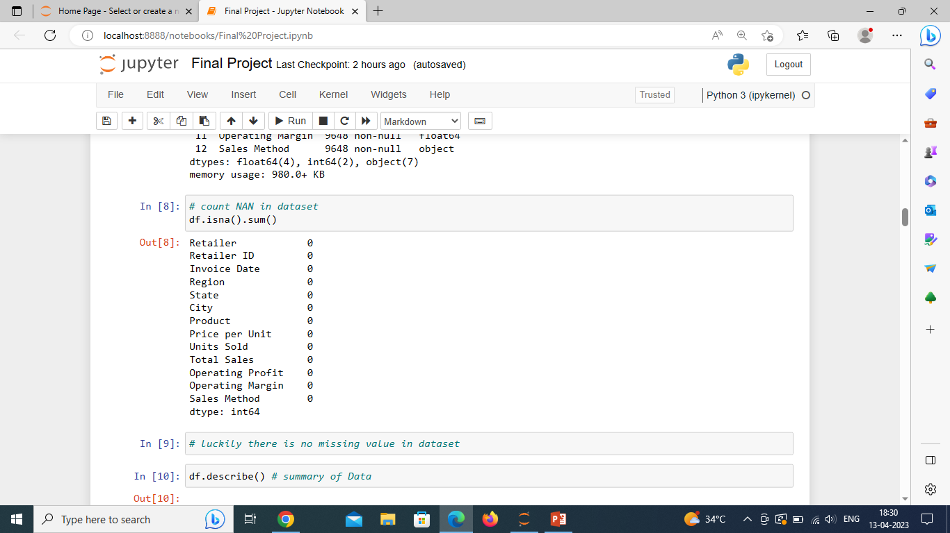
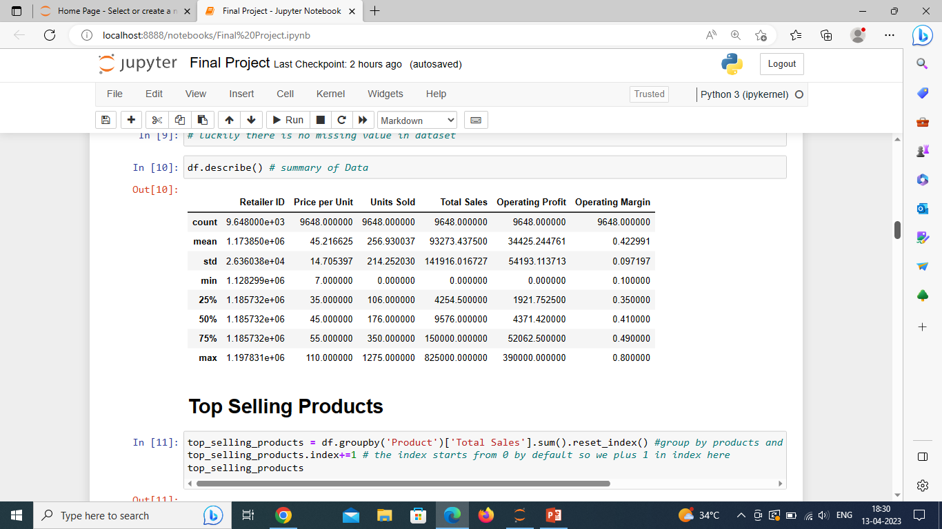
isnull().sum()returns the number of missing values in the dataset. calculating some statistical data like percentile, mean and std of the numerical values of the Series or DataFrame.

Slide 8
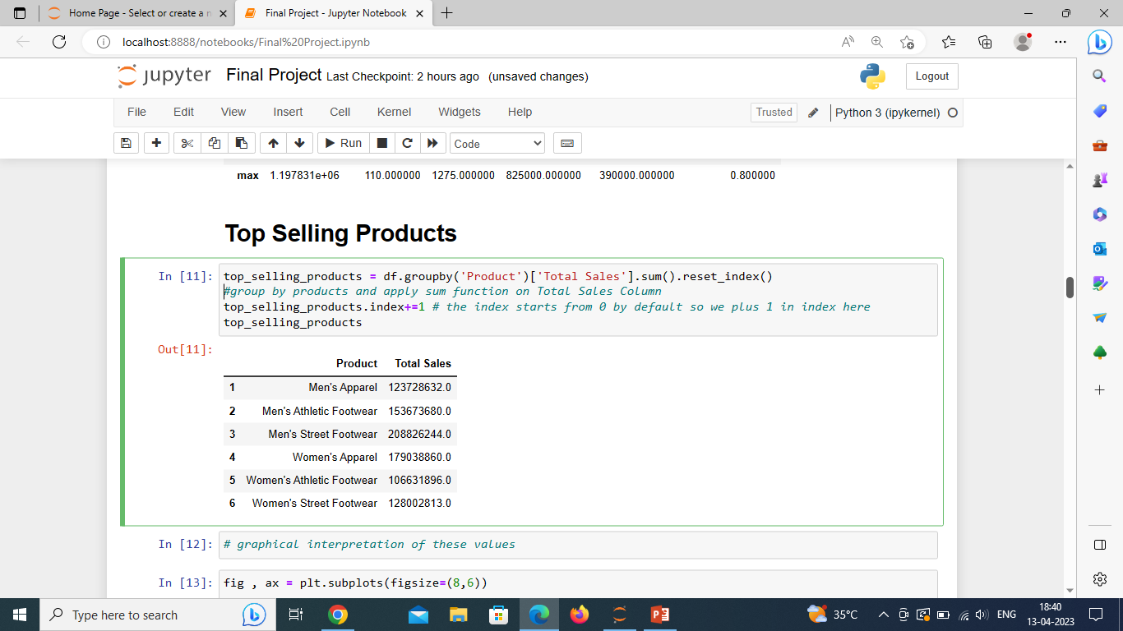
Top Selling Products

Slide 9
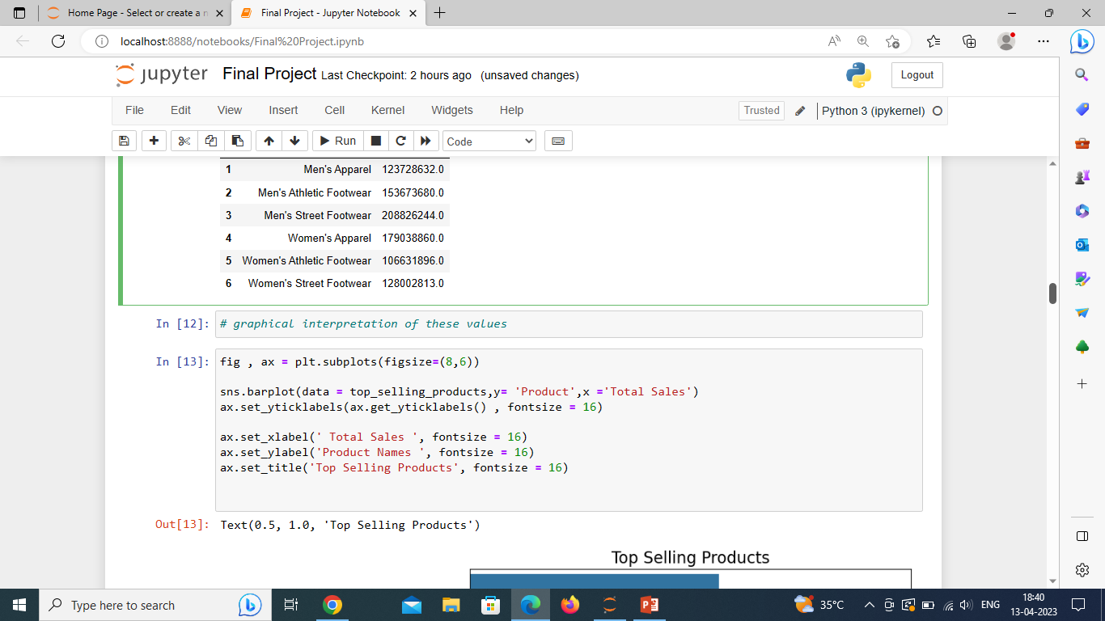
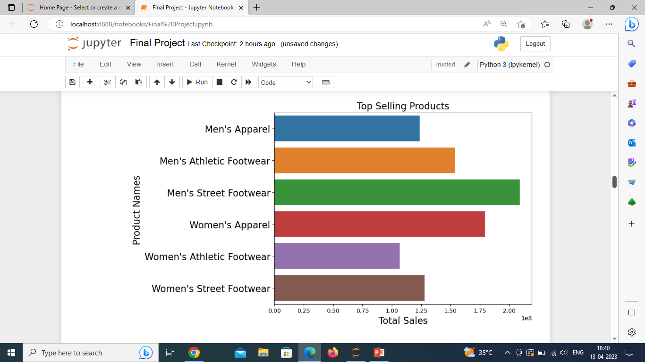
The barplot function allows creating bar charts in seaborn. This function computes the mean for each categorical variable and represents it with bars

Slide 10
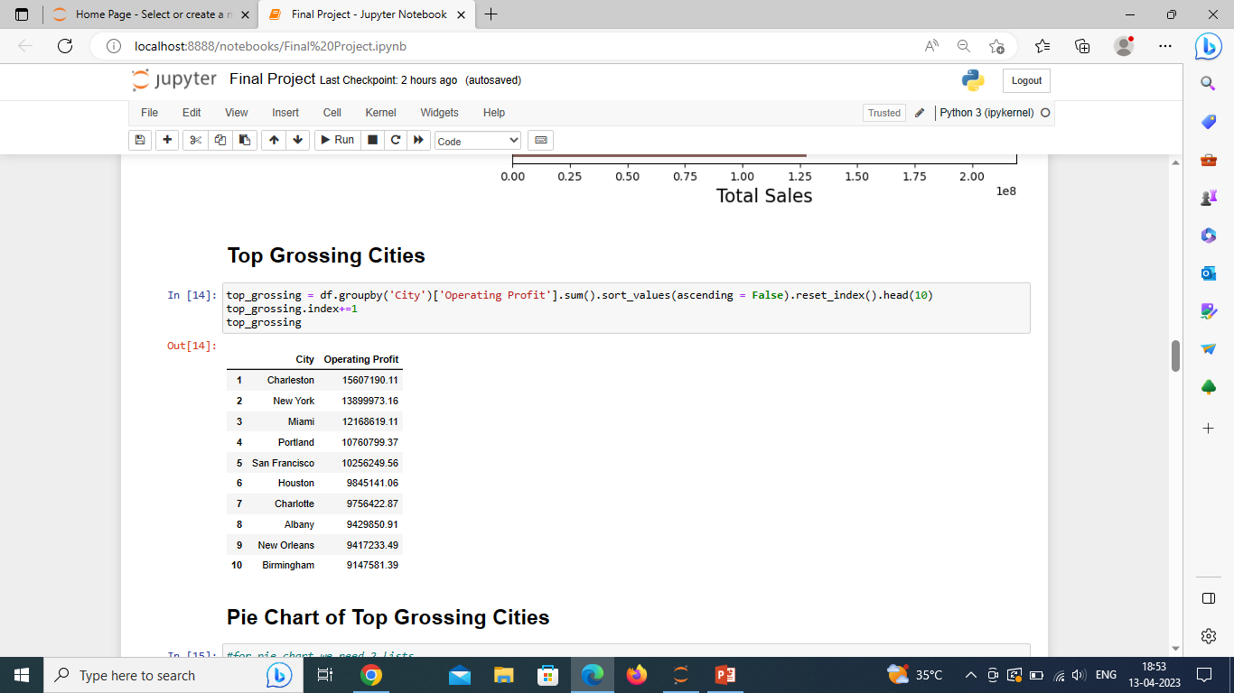
Top Grossing Cities

Slide 11
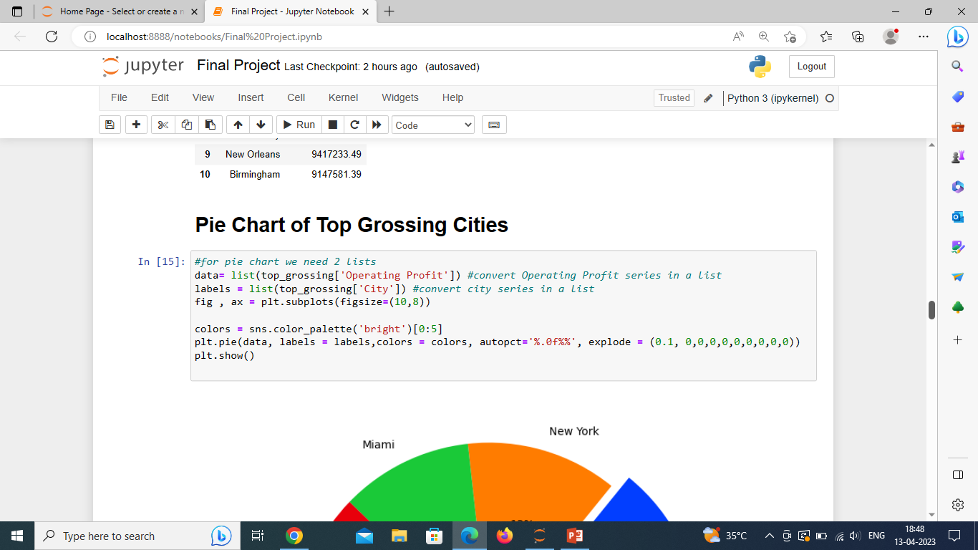
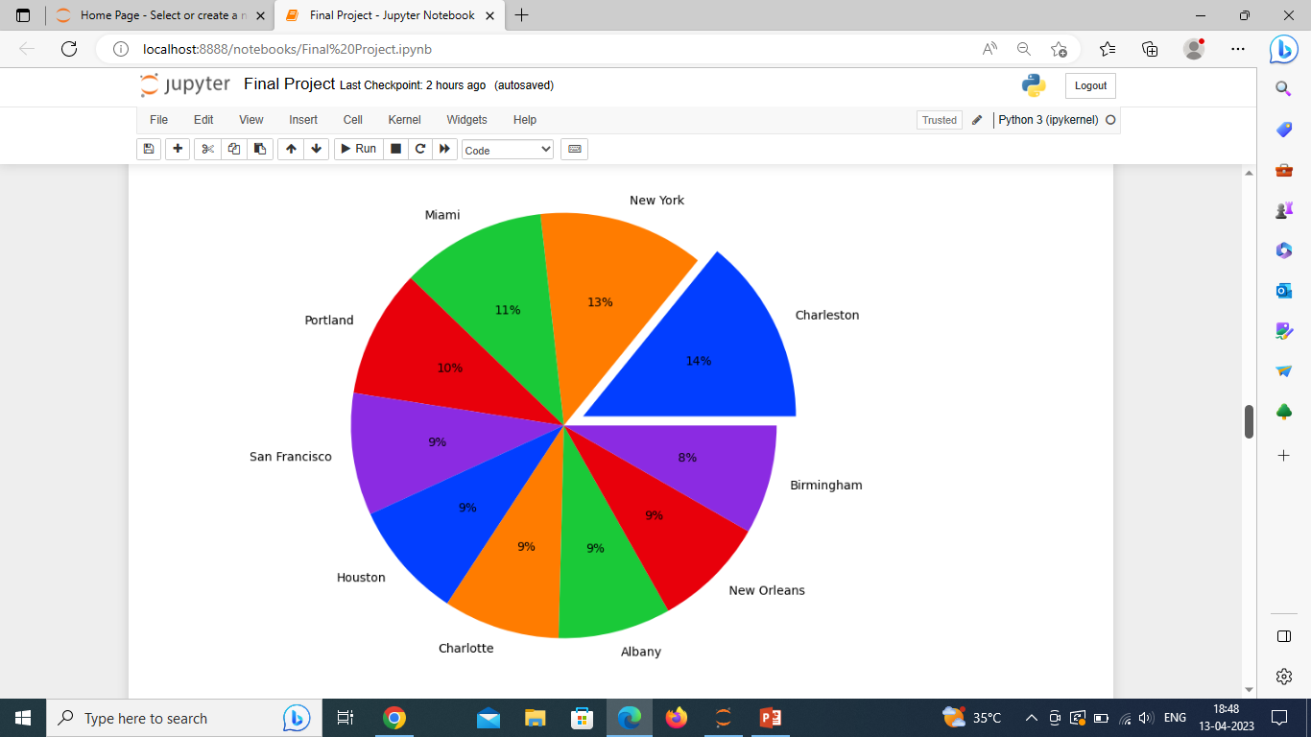
A Pie Chart can only display one series of data. Pie charts show the size of items (called wedge) in one data series, proportional to the sum of the items.

Slide 12
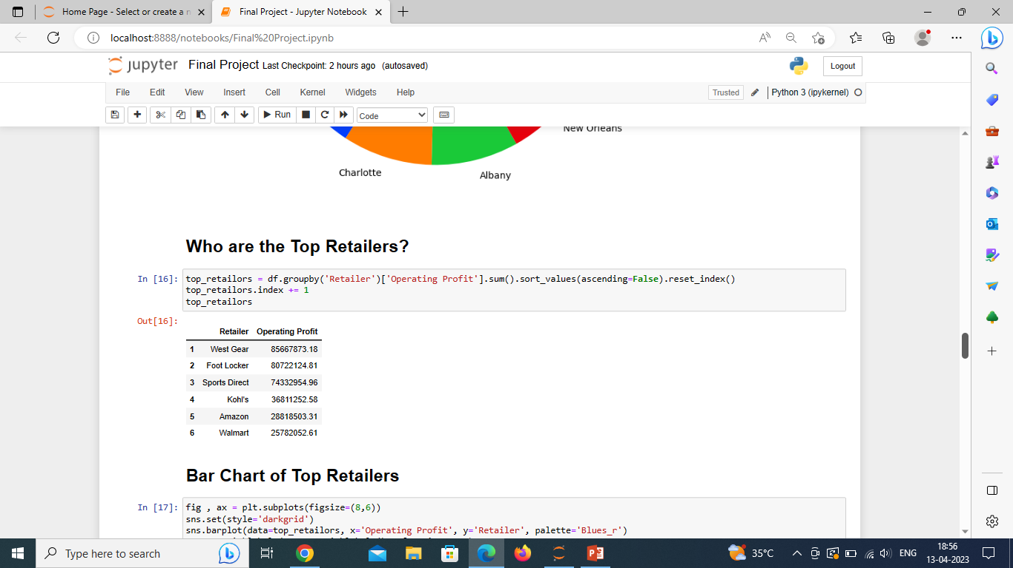
Top Retailers

Slide 13
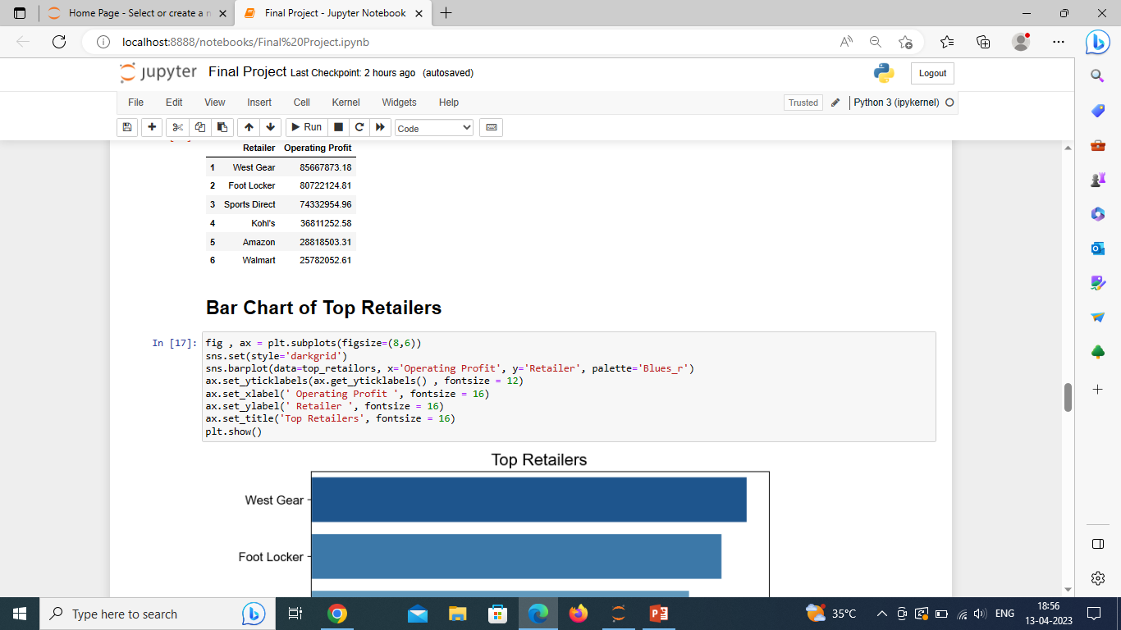
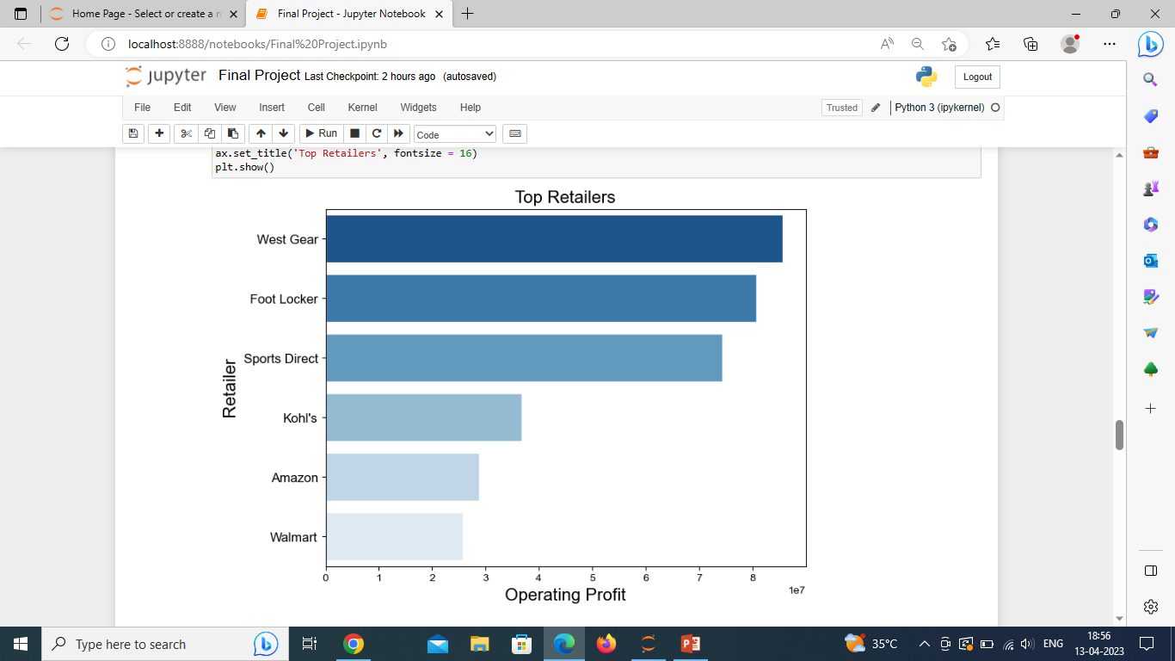
Bar Chart of Top Retailers

Slide 14
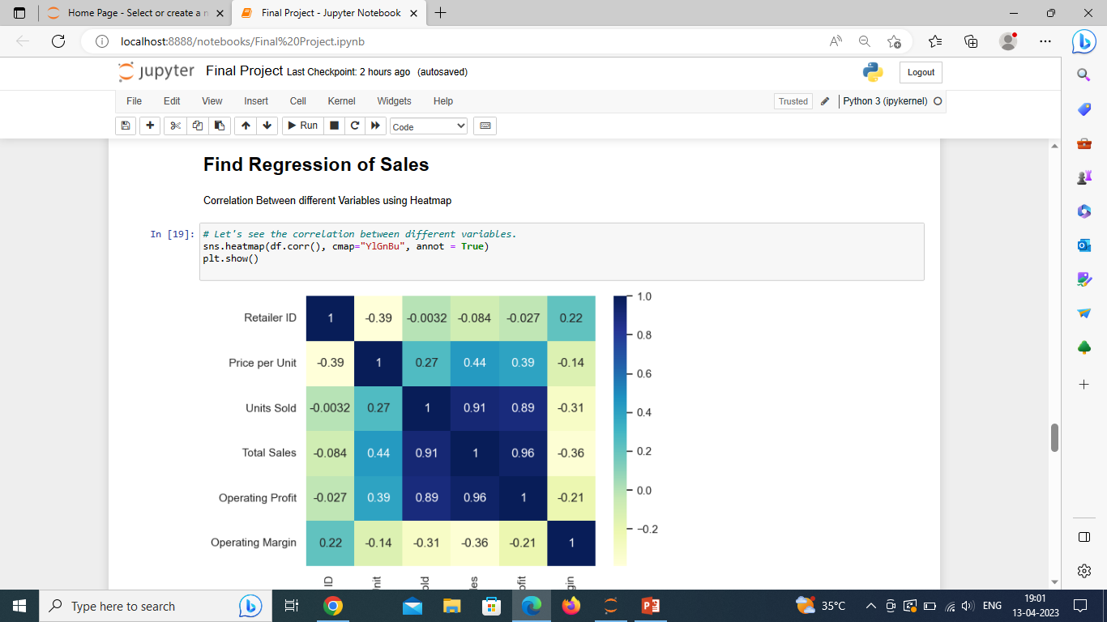
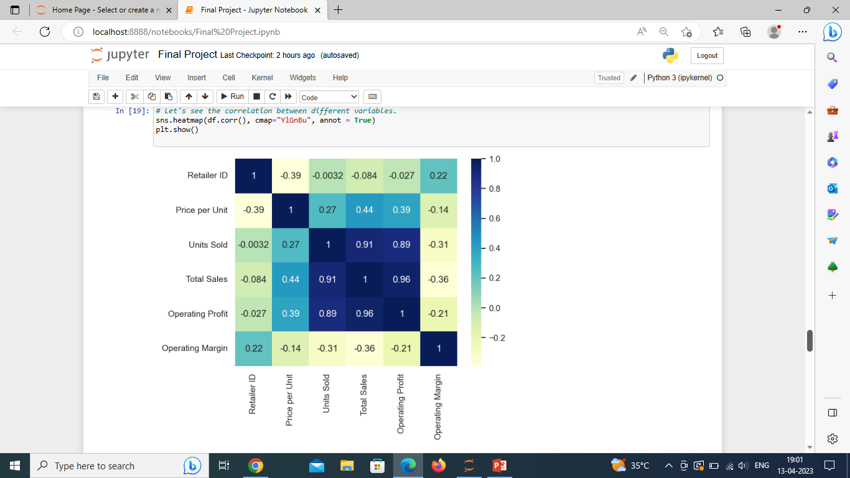
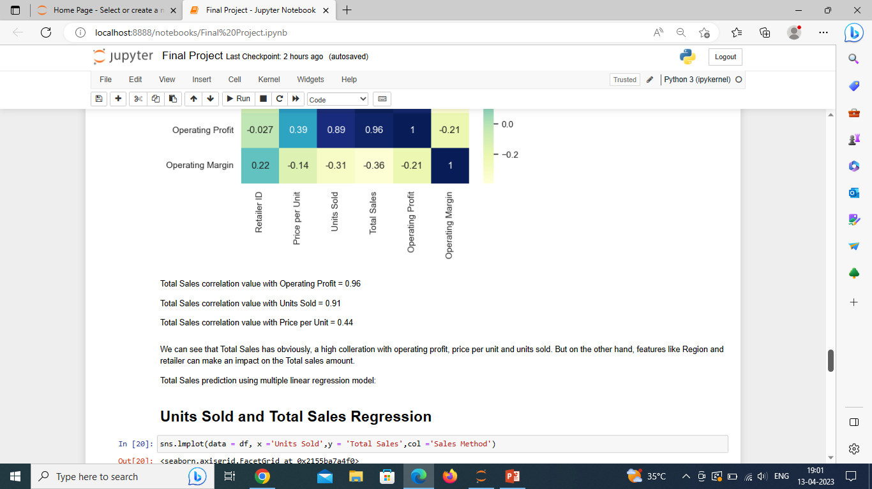
A heatmap is a data visualization technique that uses color to show how a value of interest changes depending on the values of two other variables.

Slide 15
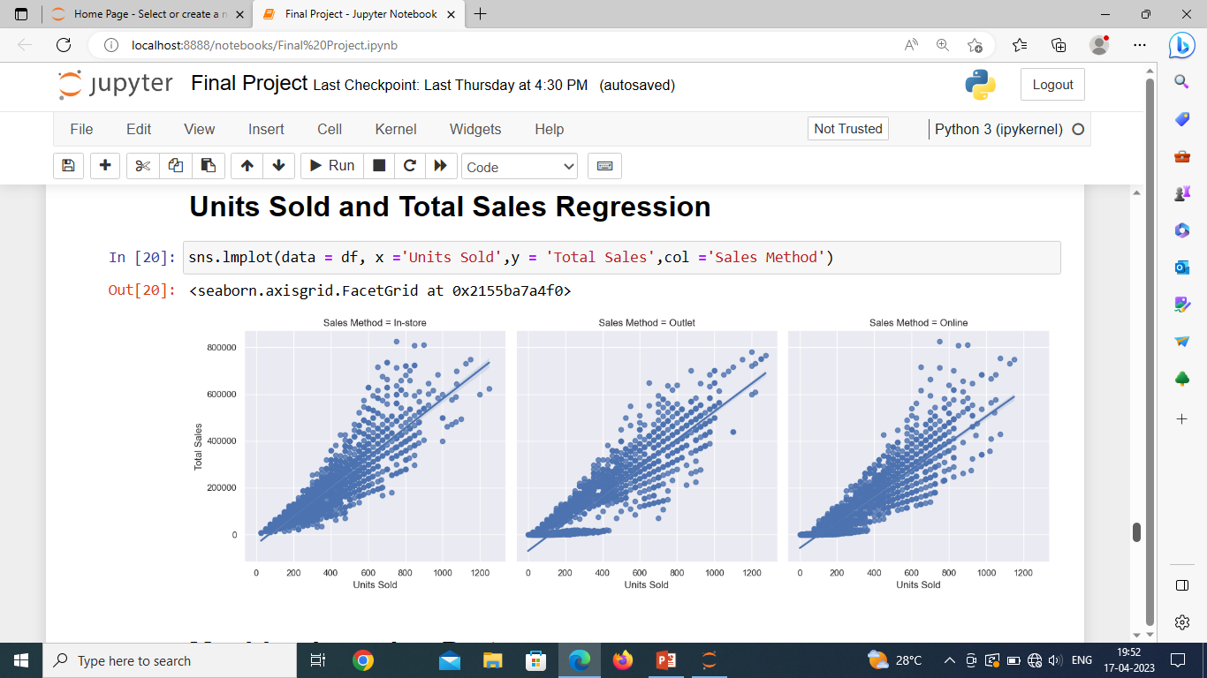
Seaborn.lmplot() method is used to plot data and draw regression model fits across grids where multiple plots can be plotted.

Slide 16
ML is a type of artificial intelligence that extract patterns out of raw data by using an algorithm or method.
Machine Learning
Machine Learning is a program that analyses data and learns to predict the outcome

Slide 17
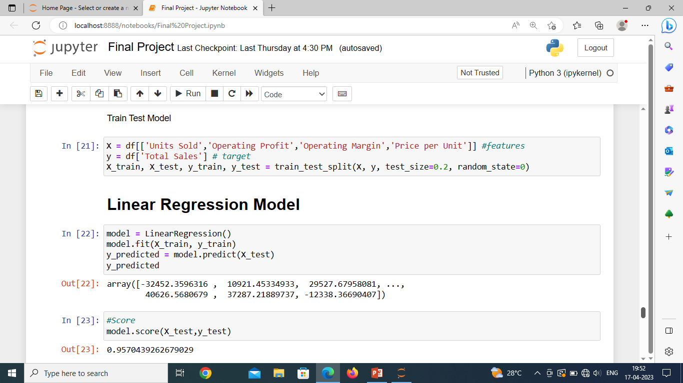
Train/Test is a method to measure the accuracy of your model.
Linear regression is one of the easiest and most popular Machine Learning algorithms. It is a statistical method that is used for predictive analysis.

Slide 18
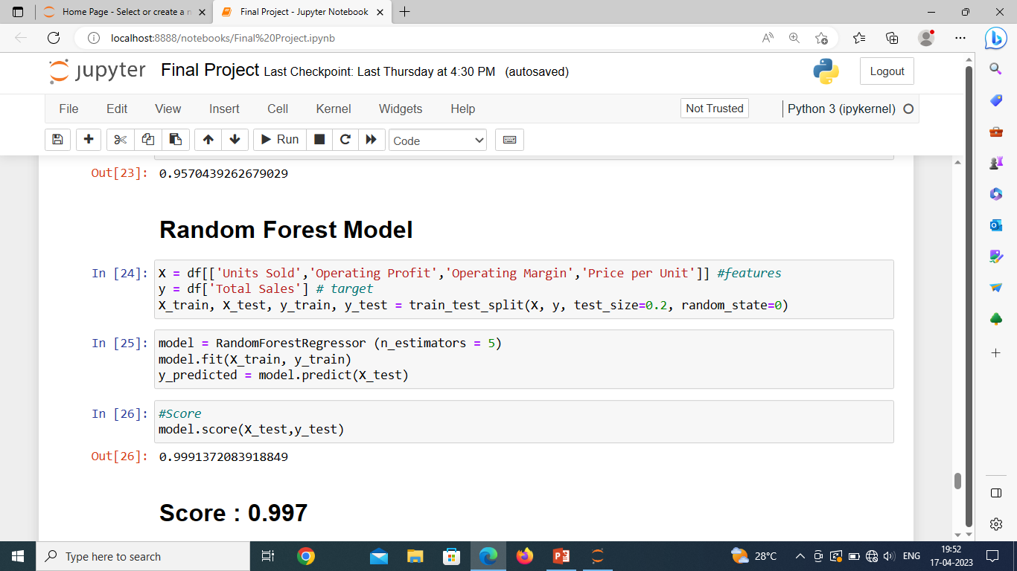
Random forest is a Supervised Machine Learning Algorithm that is used widely in Classification and Regression problems

Slide 19
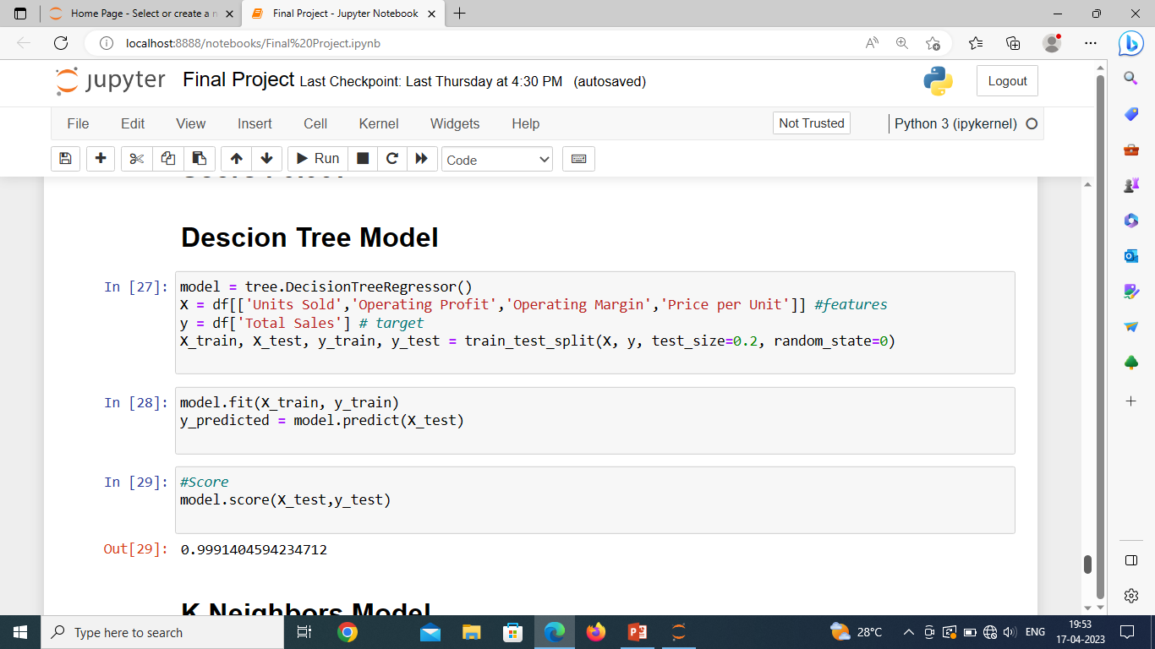
Decision trees are constructed via an algorithmic approach that identifies ways to split a data set based on different conditions.

Slide 20
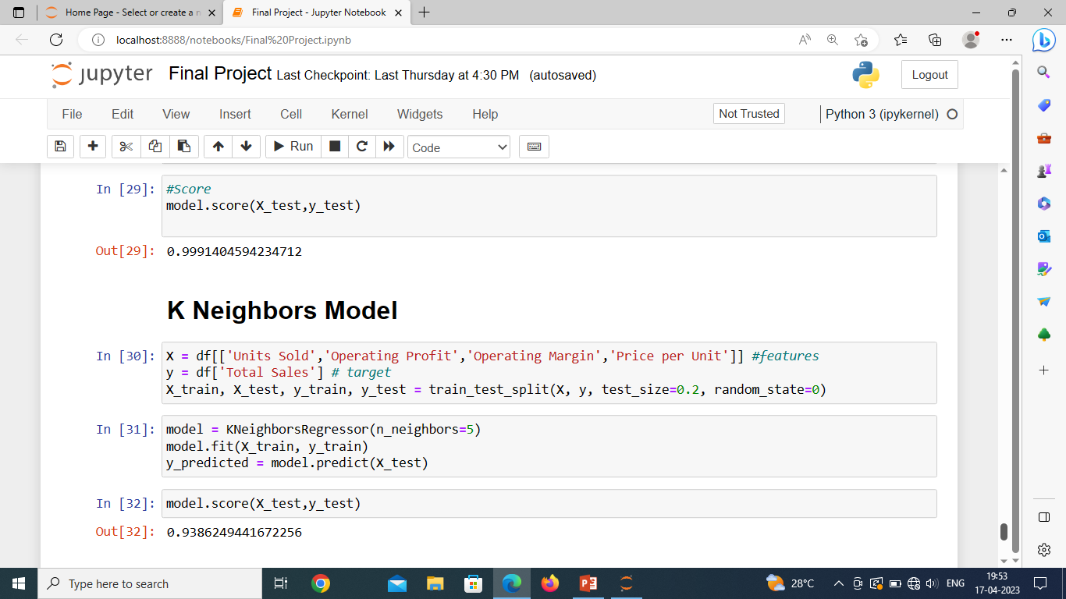
K-nearest neighbors (KNN) is a type of supervised learning algorithm used for both regression and classification. KNN tries to predict the correct class

Slide 21
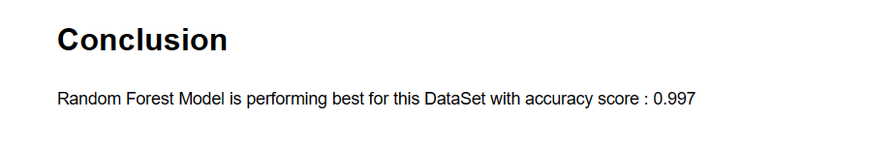

Slide 22
Project Guidance by Manish Sharma sir created and presented by Laxmikant patil

Slide 23
Thank you

